Slide 1
GENERAL INDIAN ELECTION ANALYSIS POWER BI
Presentataion By
Amal Thomas

Slide 2
WHAT IS POWER BI
POWER BI
DATA SOURCES
Power BI stands for Power Business Intelligence. It’s a collection of software services, apps, and connectors that work together to transform data from various sources into actionable insights
Power BI can connect to various data sources, including Excel spreadsheets, cloud-based databases, and hybrid data warehouses.
INSIGHTS
ROLES
Power BI helps turn data into visually immersive and interactive insights, which you can share with others
How you use Power BI depends on your role (e.g., viewing reports, creating dashboards, or embedding visuals in custom applications).

Slide 3
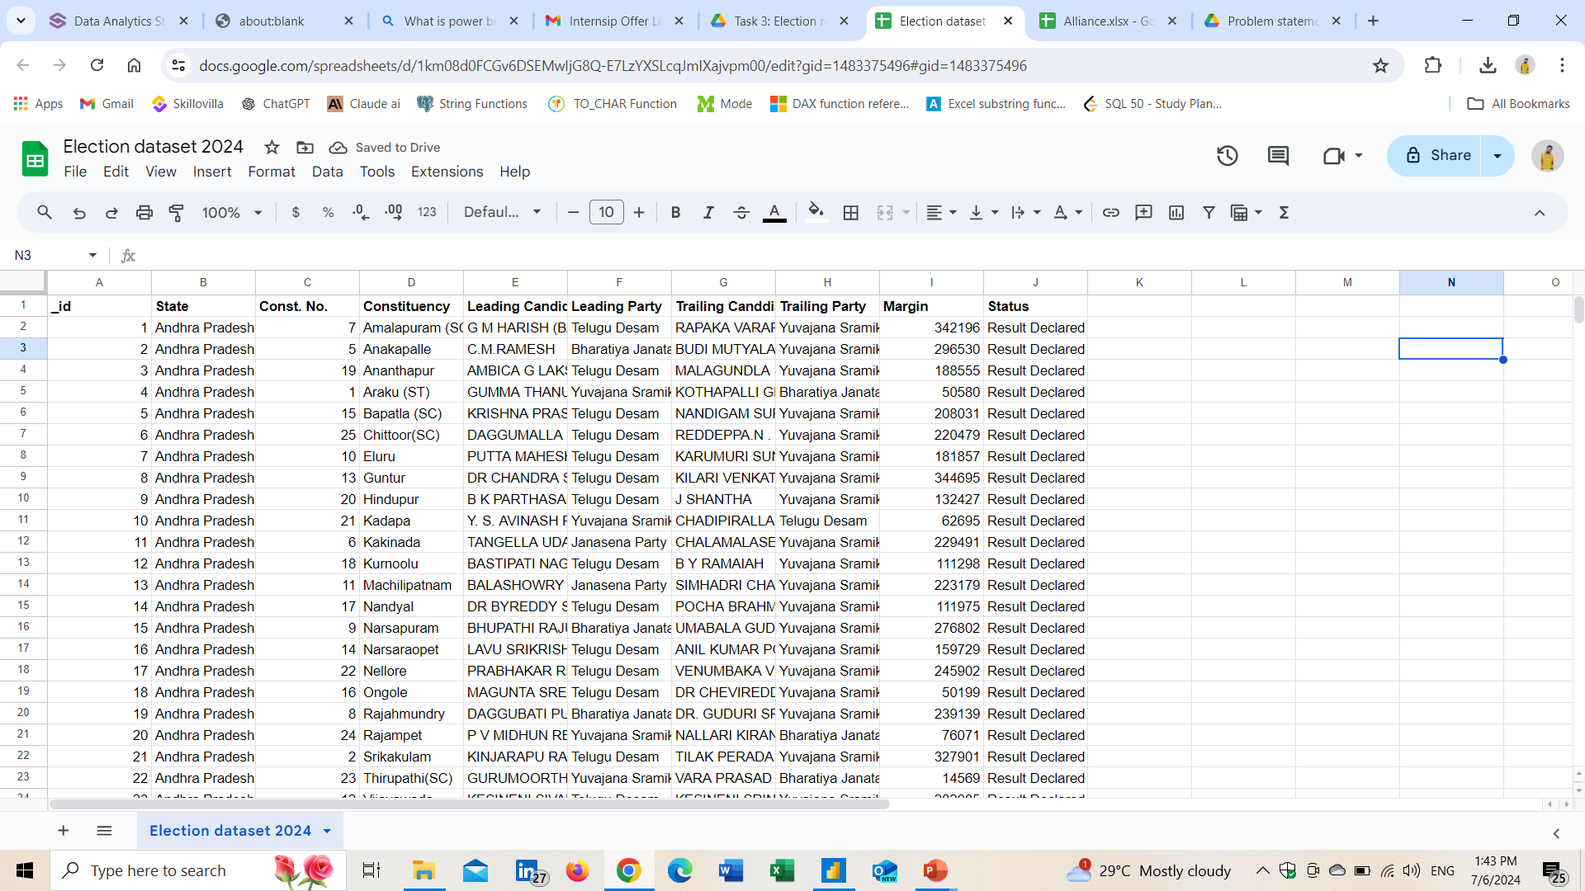
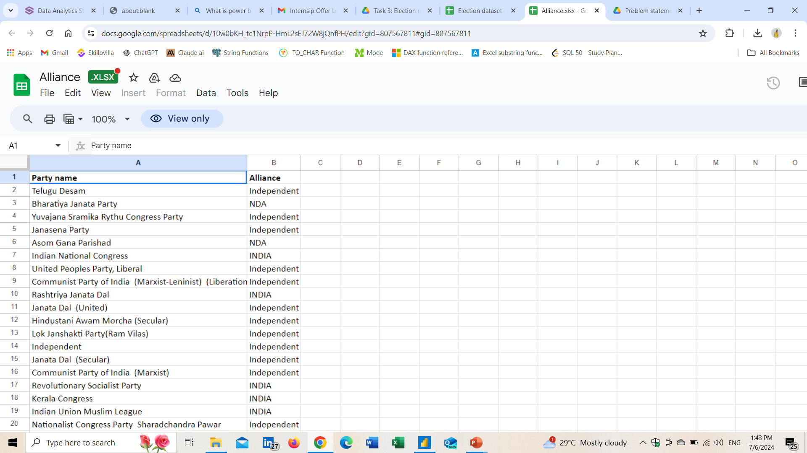
DATA SET
Election Details
Alliances

Slide 4
DISCRIPTION OF COLUMNS
Election Results Data:
- `_id`: Unique identifier for each record.
- `State`: Name of the state.
- `Const. No.`: Constituency number.
- `Constituency`: Name of the constituency.
- `Leading Candidate`: Name of the leading candidate.
- `Leading Party`: Name of the leading party.
- `Trailing Candidate`: Name of the trailing candidate.
- `Trailing Party`: Name of the trailing party.
- `Margin`: Vote margin between the leading and trailing candidates.
- `Status`: Status of the election result (e.g., Won, Lost, Leading, Trailing).
Party Alliance Data:
- `Party Name`: Name of the political party.
- `Alliance Name`: Name of the political alliance the party belongs to.

Slide 5
QUESTIONS OVER VIEW
Data Integration
Combine the election results data with the party alliance data to get a comprehensive view of which alliances are leading or trailing in various constituencies.
Data Cleaning and Preparation
Ensure data quality by checking for missing values, inconsistencies, and correcting any errors in the datasets.
Data Analysis and Visualization
Overall Results: Create a summary of the overall election results including the total number of seats won by each party and alliance.
State-wise Analysis: Visualize the performance of leading parties and alliances across different states.
Constituency-wise Analysis: Analyze and visualize the margin of victory/defeat in various constituencies.
Party and Alliance Comparison: Compare the performance of different parties and their respective alliances in terms of seats won, margins, and status.

Slide 6
QUESTIONS OVER VIEW
Interactive Dashboard:
Trend Analysis: Identify and visualize trends in voting patterns, such as regions with high competition (small margins) or dominance by specific parties or alliances.
Create an interactive dashboard that allows users to filter and explore the data by state, constituency, party, alliance, and status.
Include key performance indicators (KPIs) such as total seats won, average margin, and number of constituencies won by alliance.
Insights and Recommendations
Provide a detailed report summarizing the key insights derived from your analysis.
Offer recommendations based on the data, such as strategies for parties to improve their performance in future elections.

Slide 7
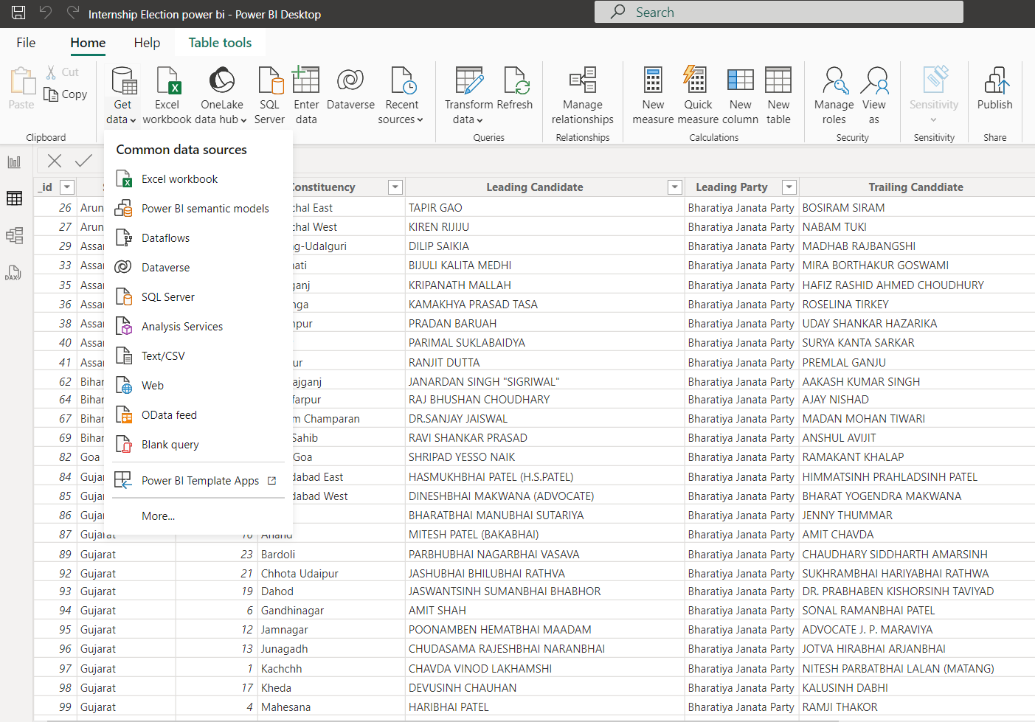
LOADING DATA IN POWER BI
HOME TAB
GET DATA
SELECT DATA TYPE
SELECT DATA
LOAD AND TRANSFORM

Slide 8
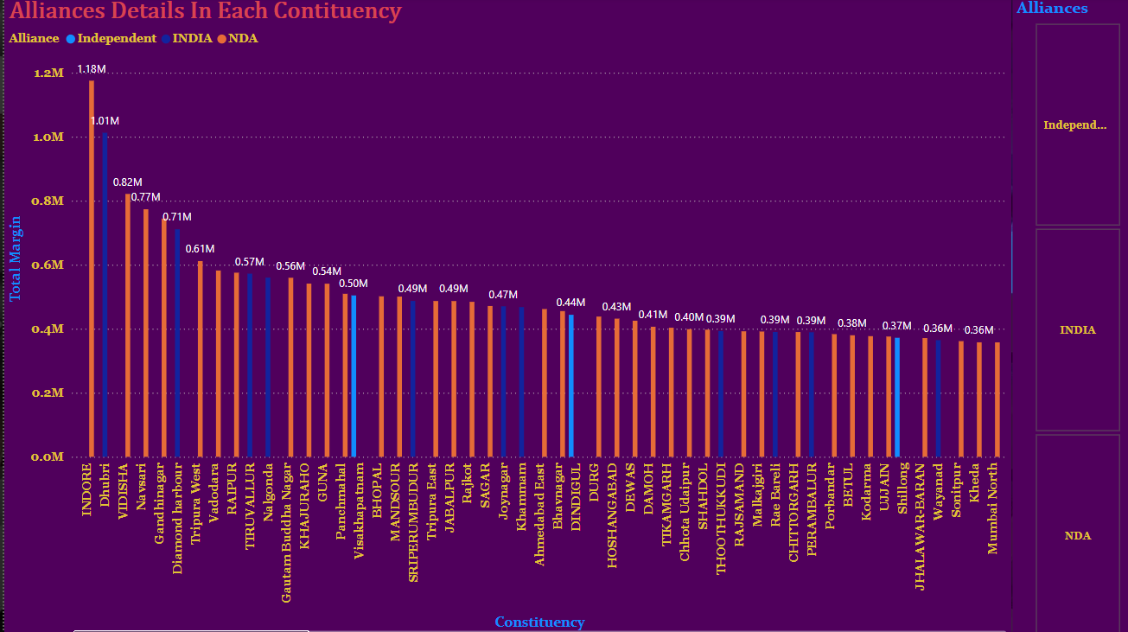
Data Integration
Combine the election results data with the party alliance data to get a comprehensive view of which alliances are leading or trailing in various constituencies.

Slide 9
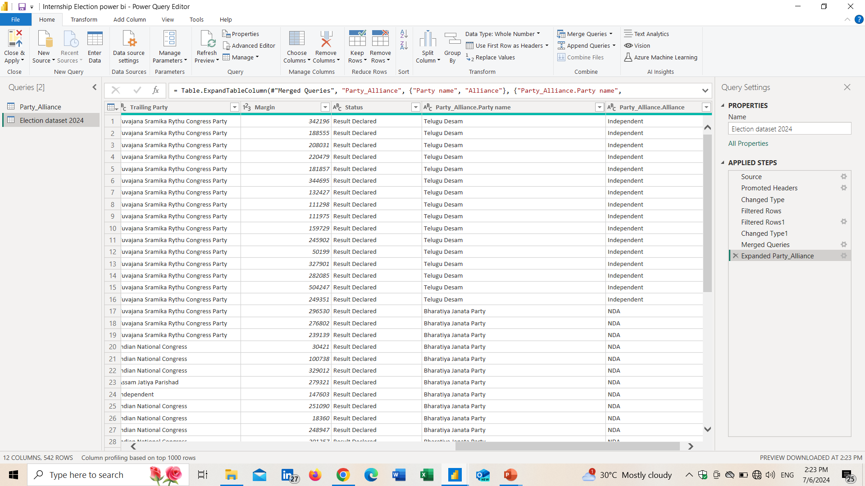
Data Cleaning and Preparation
Ensure data quality by checking for missing values, inconsistencies, and correcting any errors in the datasets.

Slide 10
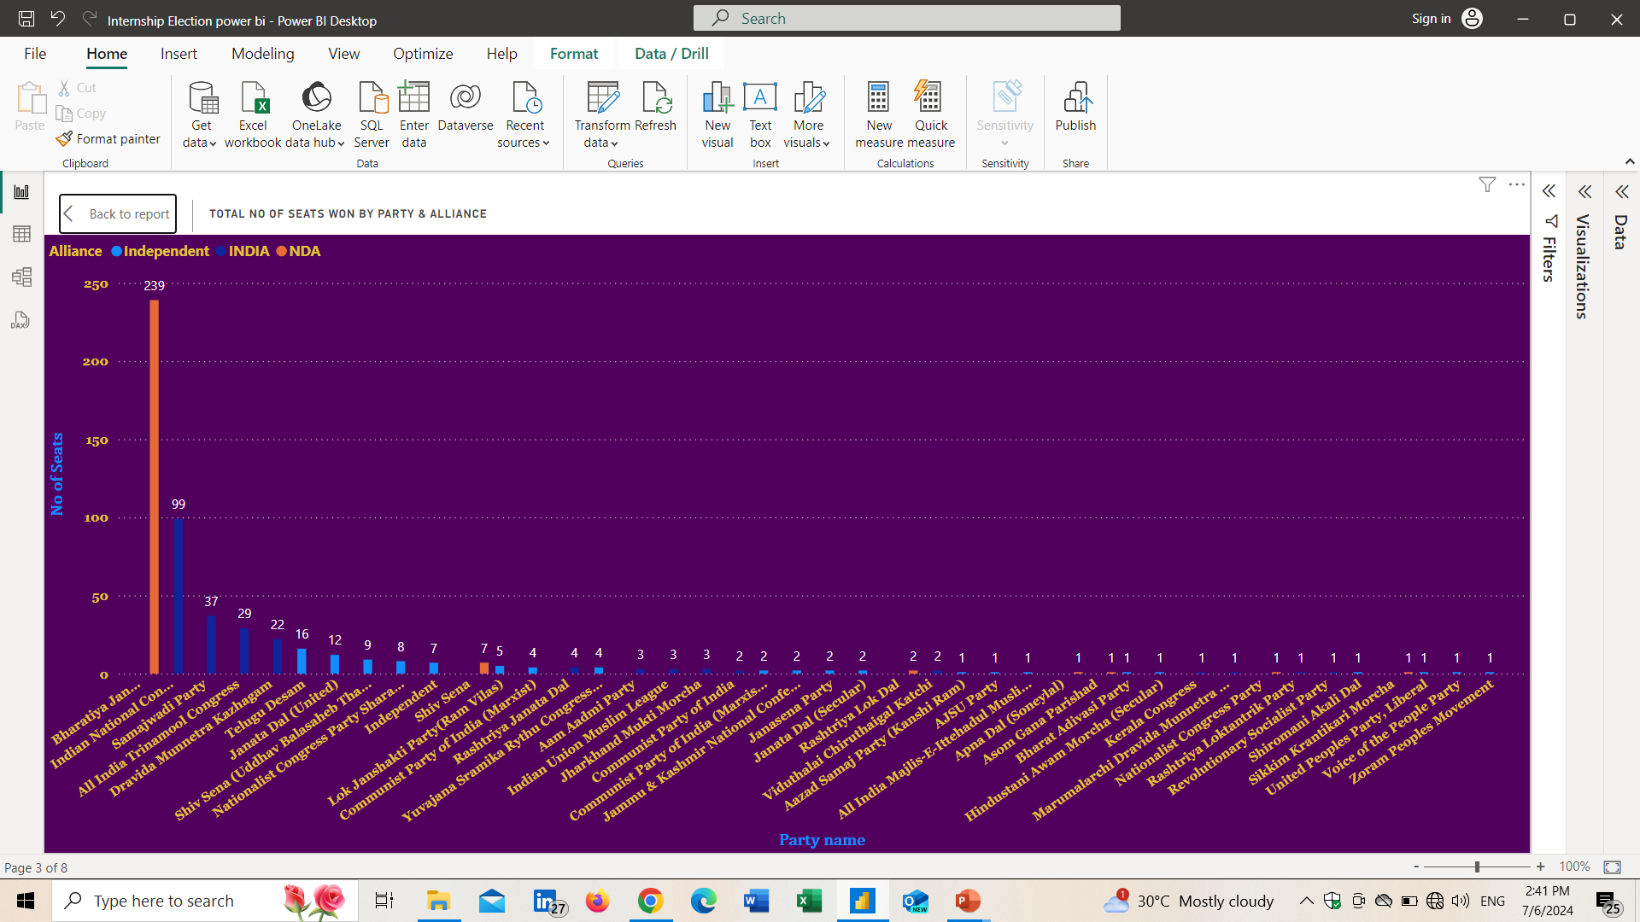
Data Analysis and Visualization
Overall Results: Create a summary of the overall election results including the total number of seats won by each party and alliance.

Slide 11
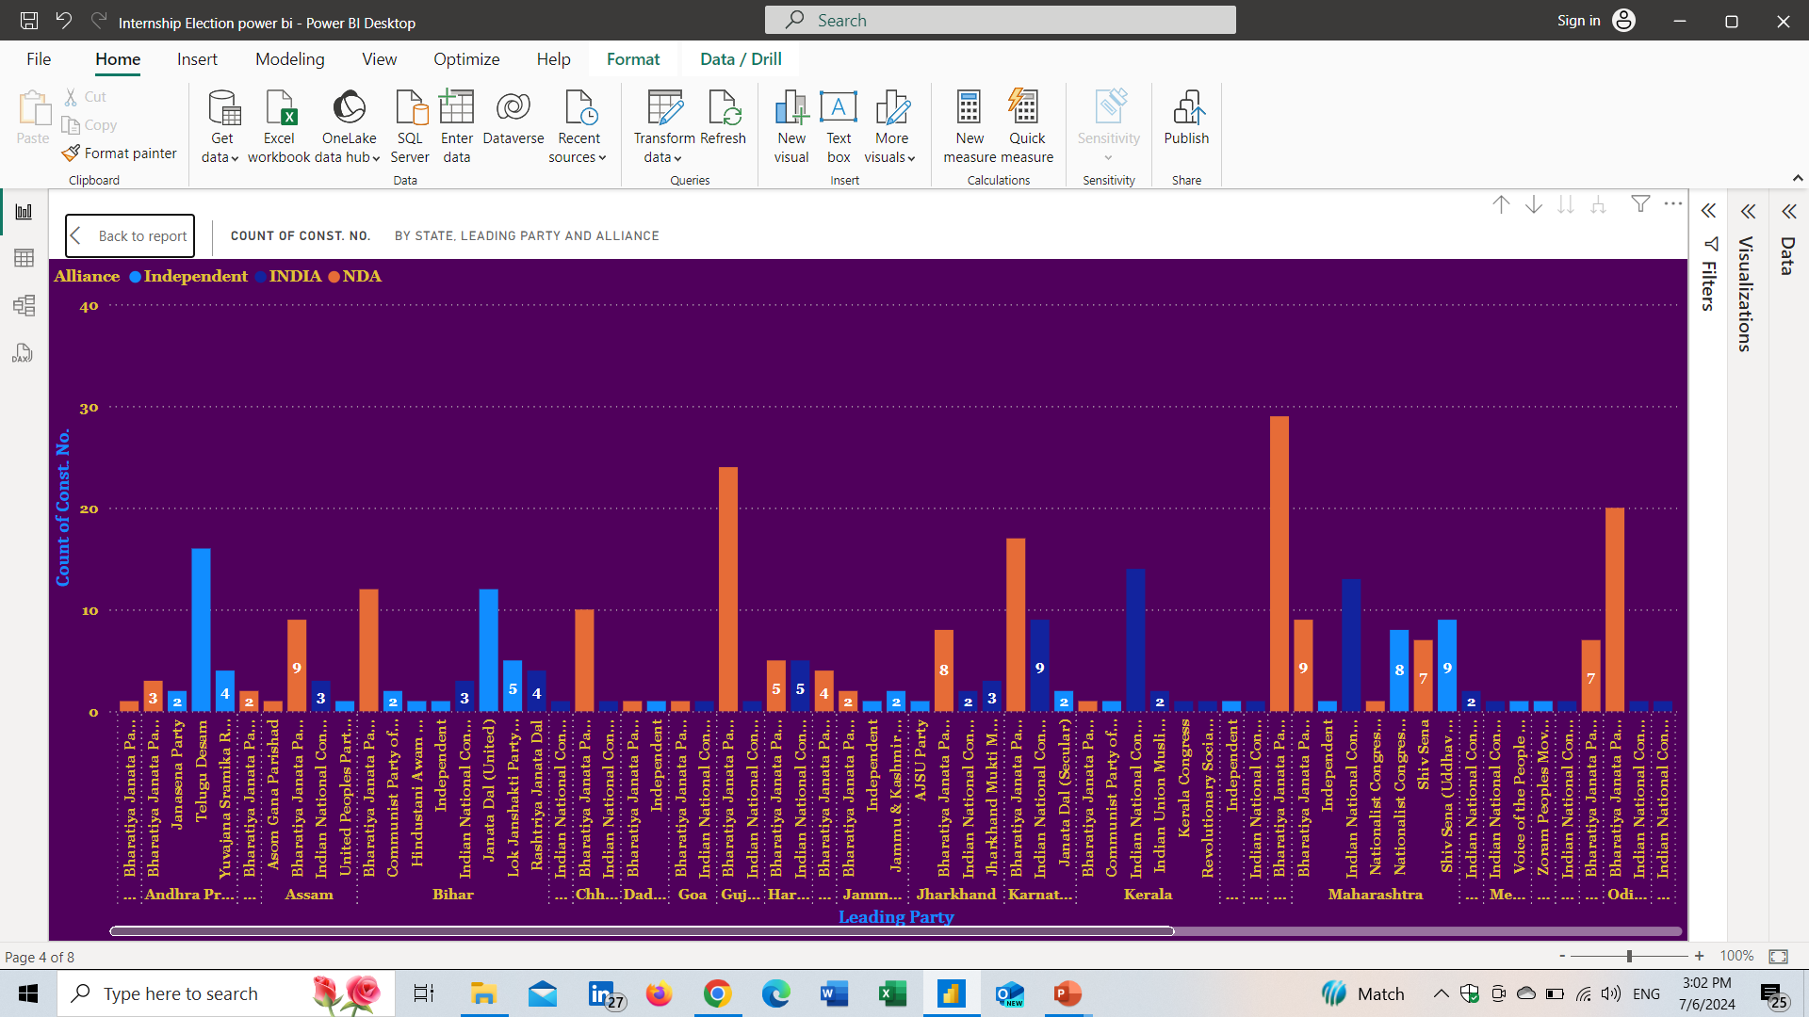
Data Analysis and Visualization
State-wise Analysis: Visualize the performance of leading parties and alliances across different states.

Slide 12
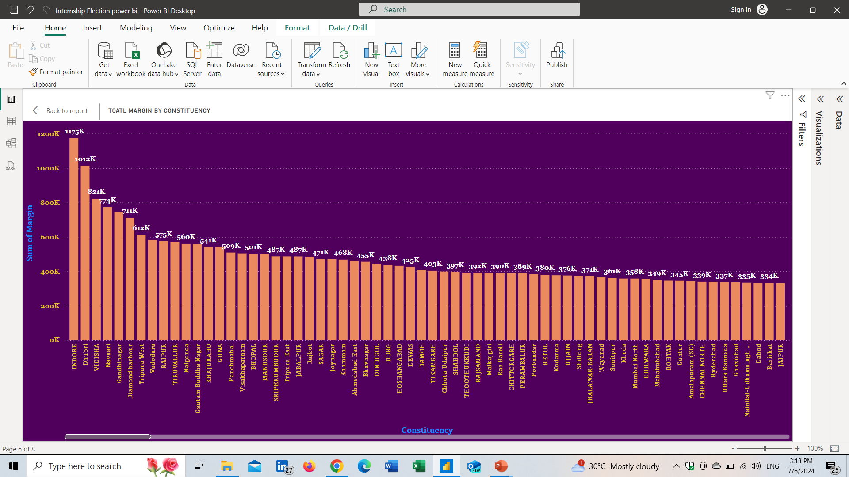
Data Analysis and Visualization
Constituency-wise Analysis: Analyze and visualize the margin of victory/defeat in various constituencies.

Slide 13
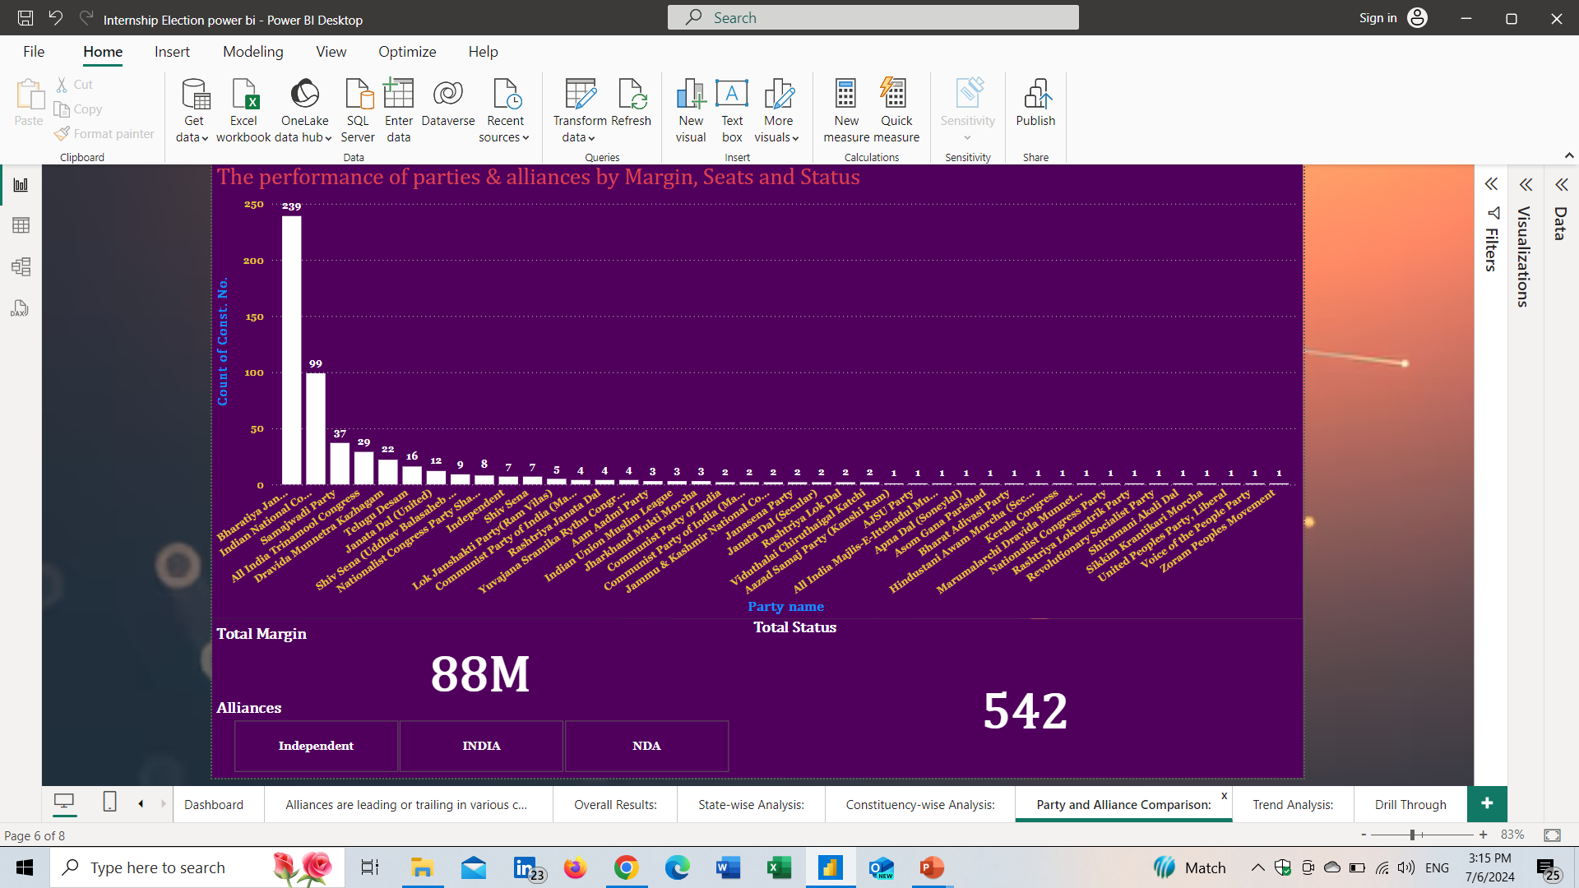
Data Analysis and Visualization
Party and Alliance Comparison: Compare the performance of different parties and their respective alliances in terms of seats won, margins, and status.

Slide 14
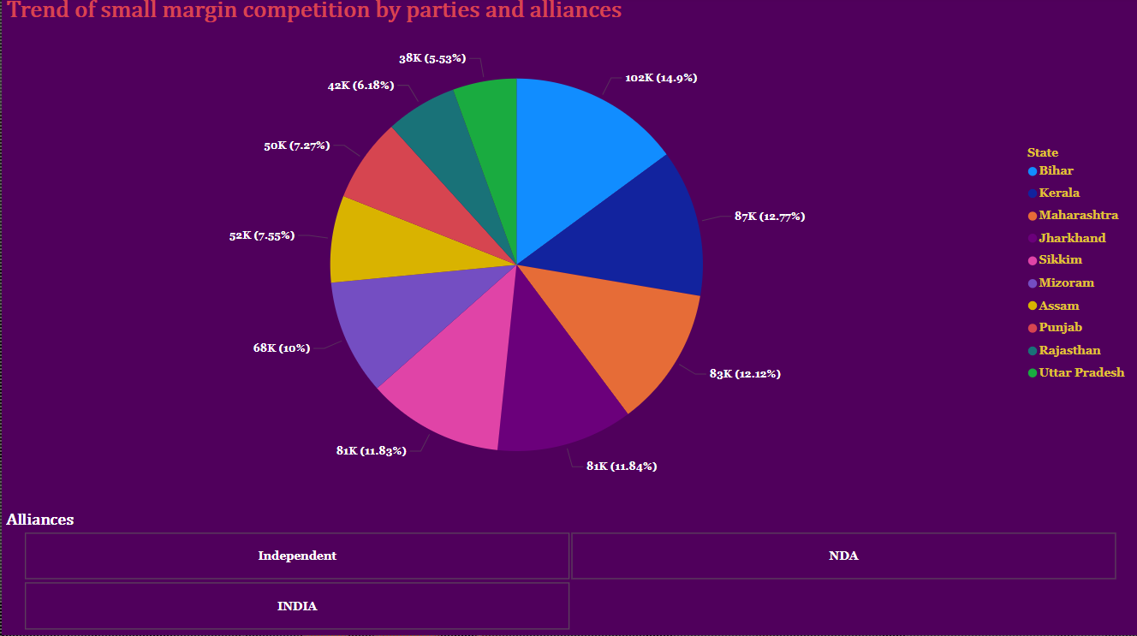
Interactive Dashboard
Trend Analysis: Identify and visualize trends in voting patterns, such as regions with high competition (small margins) or dominance by specific parties or alliances.

Slide 15
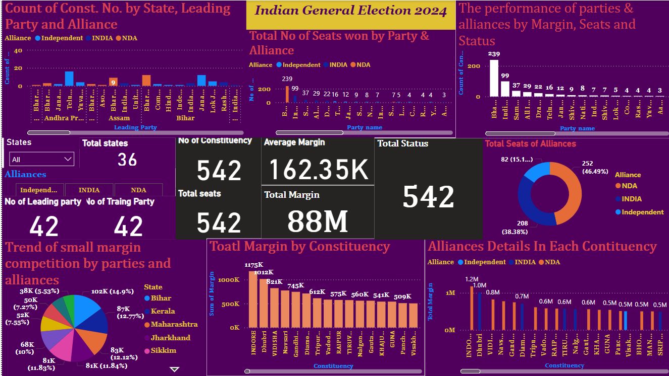
Interactive Dashboard
Create an interactive dashboard that allows users to filter and explore the data by state, constituency, party, alliance, and status.
Include key performance indicators (KPIs) such as total seats won, average margin, and number of constituencies won by alliance

Slide 16
INSIGHTS
NDA is leading across all other allinces in all the constituency with 1.18M total margin
Bharatiya Janata Party and its alliances NDA is having highest number of seats won with 239
NDA alliances are leading in majority of states and INDIA alliances are second
INDORE constiuency is having highest total margin across all others with 1175K
The performance of parties, alliances is very high for Bharatiya Janata Party and NDA by 47M total margin, 252 total won areas and 239 seats for BJP
In small margin competition last 10 parties and alliances are there. The small competition takes place in Karala, Bihar and Maharashtra

Slide 17
STRATERGIES
INC and BJP are the major competitors across all other parties and the major alliances are NDA and INDIA
Localize Campaigns: The INC should focus on state-level campaigns, cultivating strong local leaders and addressing region-specific issues. This approach helps connect with voters and build trust.
Strategic Alliances: Collaborate with like-minded parties such as the Samajwadi Party (SP), Rashtriya Janata Dal (RJD), and Shiv Sena. Strategic seat-sharing can optimize chances of victory in specific constituencies.
Target Direct Contests: The INC needs to win direct contests against the Bharatiya Janata Party (BJP). Winning around 50 of the 200-odd direct contest seats with the BJP could help the INC cross the 100-seat mark
Focus on Key States: Prioritize states where the INC has historically performed well, such as Kerala, Punjab, and parts of Karnataka. Winning consistently in these states can contribute significantly to the overall seat count.
Address Voter Concerns: Address issues like joblessness, rising prices, and economic challenges. Connecting with voters on these fronts can resonate positively.

Slide 18
THANKS!

